Slide 1
SMTP
(Simple Mail Transfer Protocol)

Slide 2
Definition
SMTP is a push protocol and is used to send the mail whereas POP (post office protocol) or IMAP (internet message access protocol) are used to retrieve those mails at the receiver’s side.
SMTP is used in internet systems as a method to transfer mail from one user to another.

Slide 3
SMTP Fundamentals
SMTP is an application layer protocol.
The client who wants to send the mail opens a TCP connection to the SMTP server and then sends the mail across the connection.
The SMTP server is always on listening mode.
As soon as it listens for a TCP connection from any client, the SMTP process initiates a connection on that port .
After successfully establishing the TCP connection the client process sends the mail instantly.

Slide 4
SMTP Protocol
The SMTP model is of two type :
1. End-to- end method
2. Store-and- forward method
The end to end model is used to communicate between different organizations whereas the store and forward method are used within an organization.

Slide 5
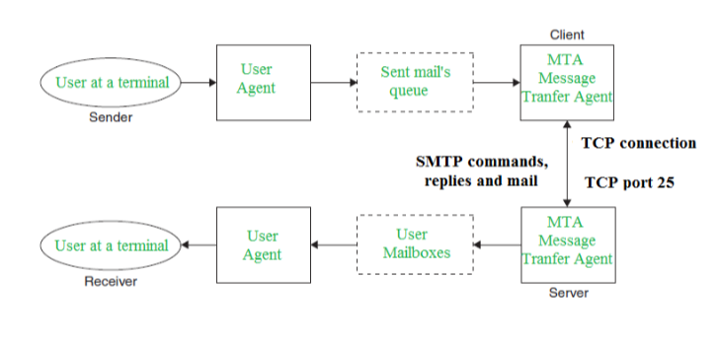
Model of SMTP System

Slide 6
Communication Between Sender & Receiver
The senders, user agent prepare the message and send it to the MTA.
The MTA functioning is to transfer the mail across the network to the receivers MTA.
To send mail, a system must have the client MTA, and to receive mail, a system must have a server MTA.

Slide 7
Some SMTP Components
HELO – Identifies the client to the server, fully qualified domain name, only sent once per session
MAIL – Initiate a message transfer, fully qualified domain of originator
DATA – send data line by line

Slide 8
Thank You

